Slide 1




The influence of landscape variation on landform categorisation
Maia Williams
GeoMundus
Münster
28 October 2011

Slide 2
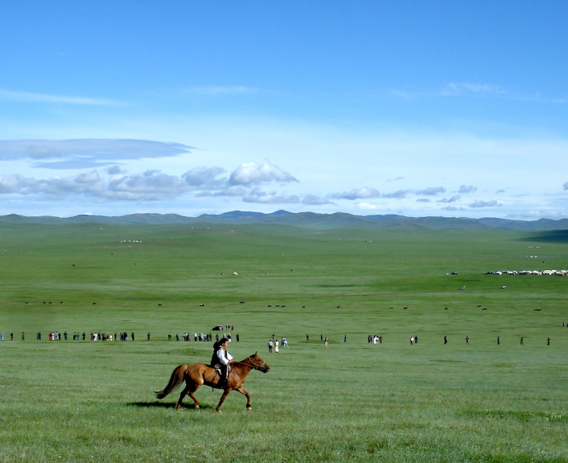
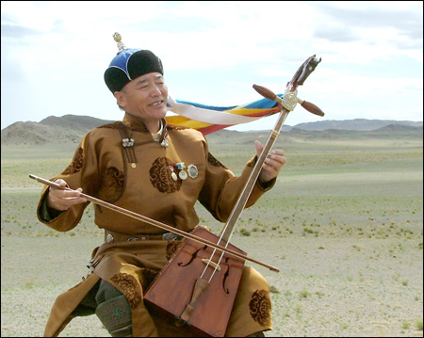
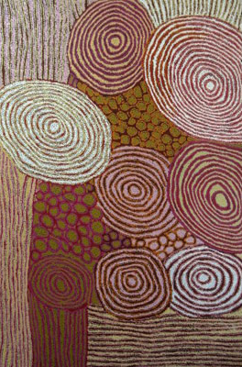
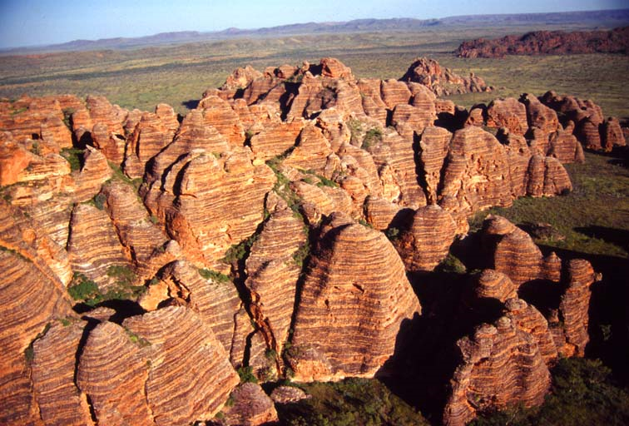
Introduction
Cross cultural, language, location and domain GIS use
Assumptions of universally understood geographic categories
Geographic categories influenced by
culture and beliefs
language
environment
the individual
1 of 16

Slide 3
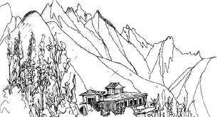
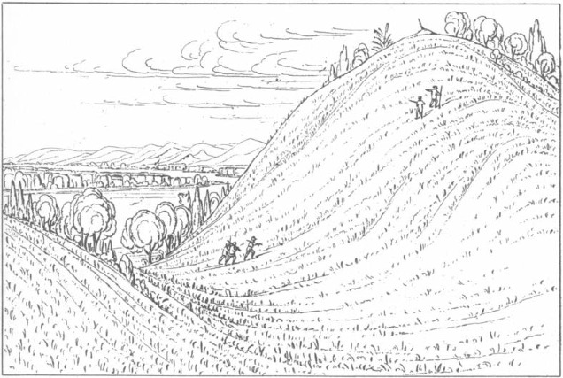
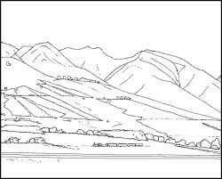
Landform categorisation
What landform terms are used?
Where?
How?
Human categorisation vs computed classification
2 of 16

Slide 4
Research questions
Do people identify landform categorisations with greater degrees of detail in landscapes they are familiar with, compared to lesser known landscapes?
How do the categories people identify compare with an elevation-based automated landform classification?
Is there any evidence suggesting that landscape categories are developed according to utilitarian factors more than salient features?
3 of 16

Slide 5
Research approach
Participant landform categorisation
Study site 1
Participant landform categorisation
Study site 2
DEM-based landform classification
Study site 1
DEM-based landform classification
Study site 2
: Qualitative comparison
: Quantitative comparison
4 of 16

Slide 6
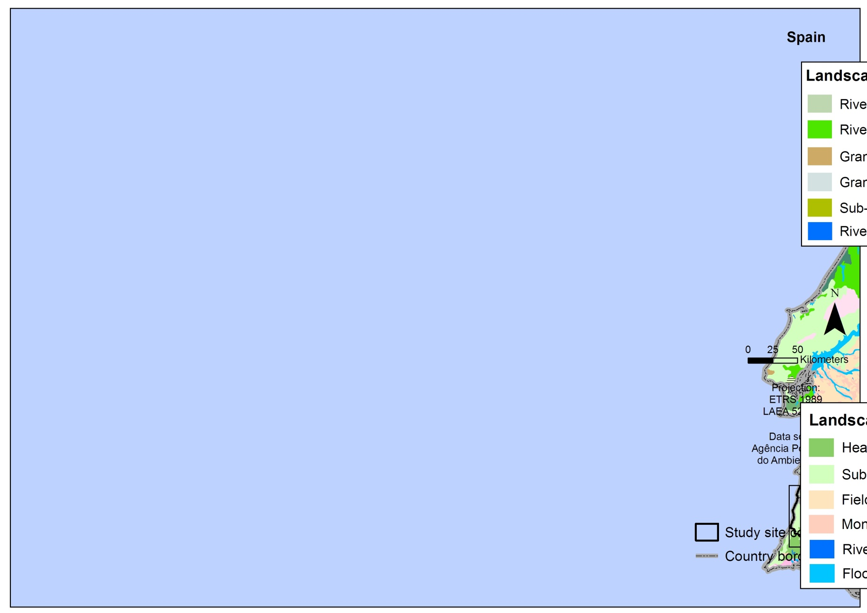
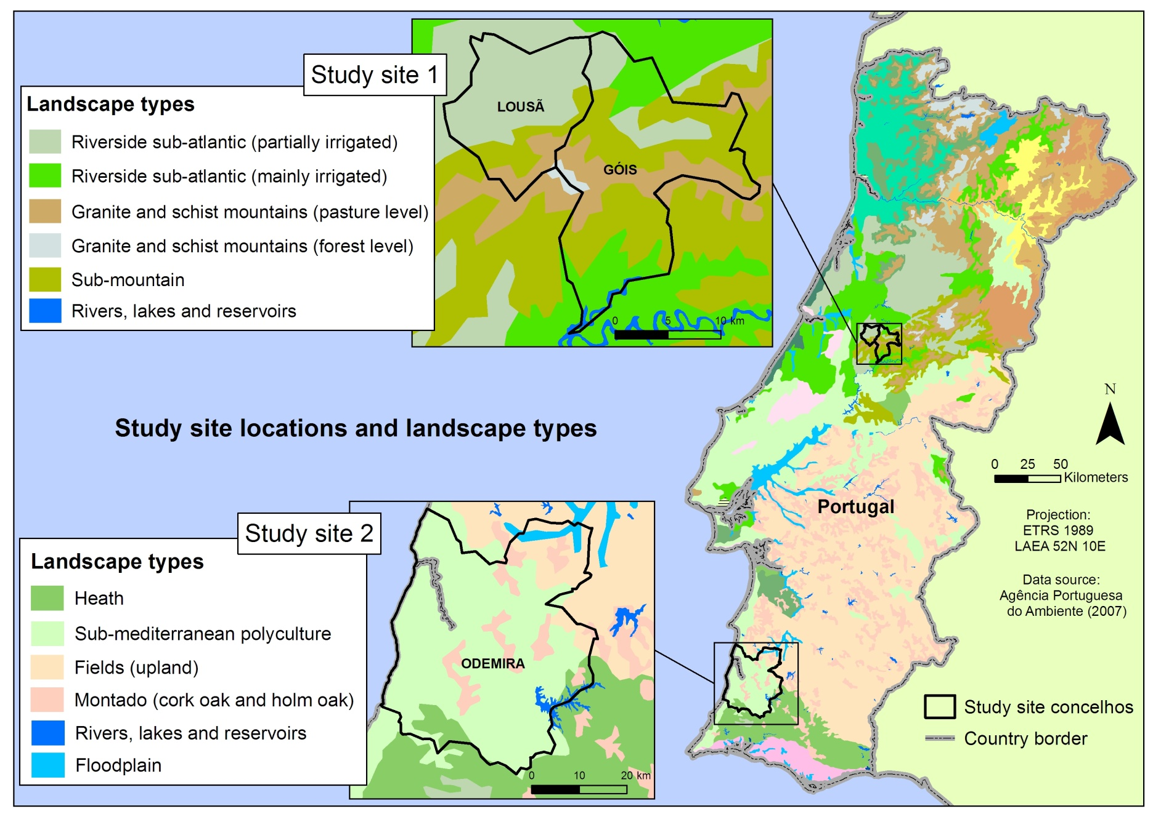
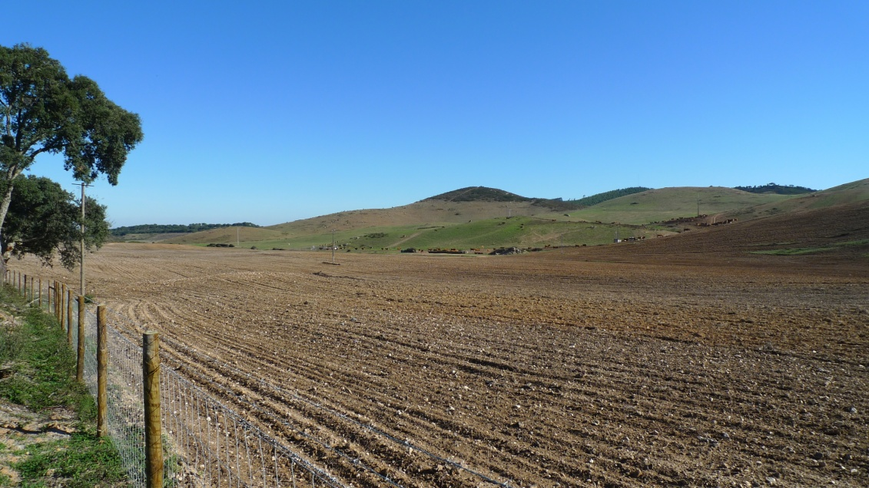
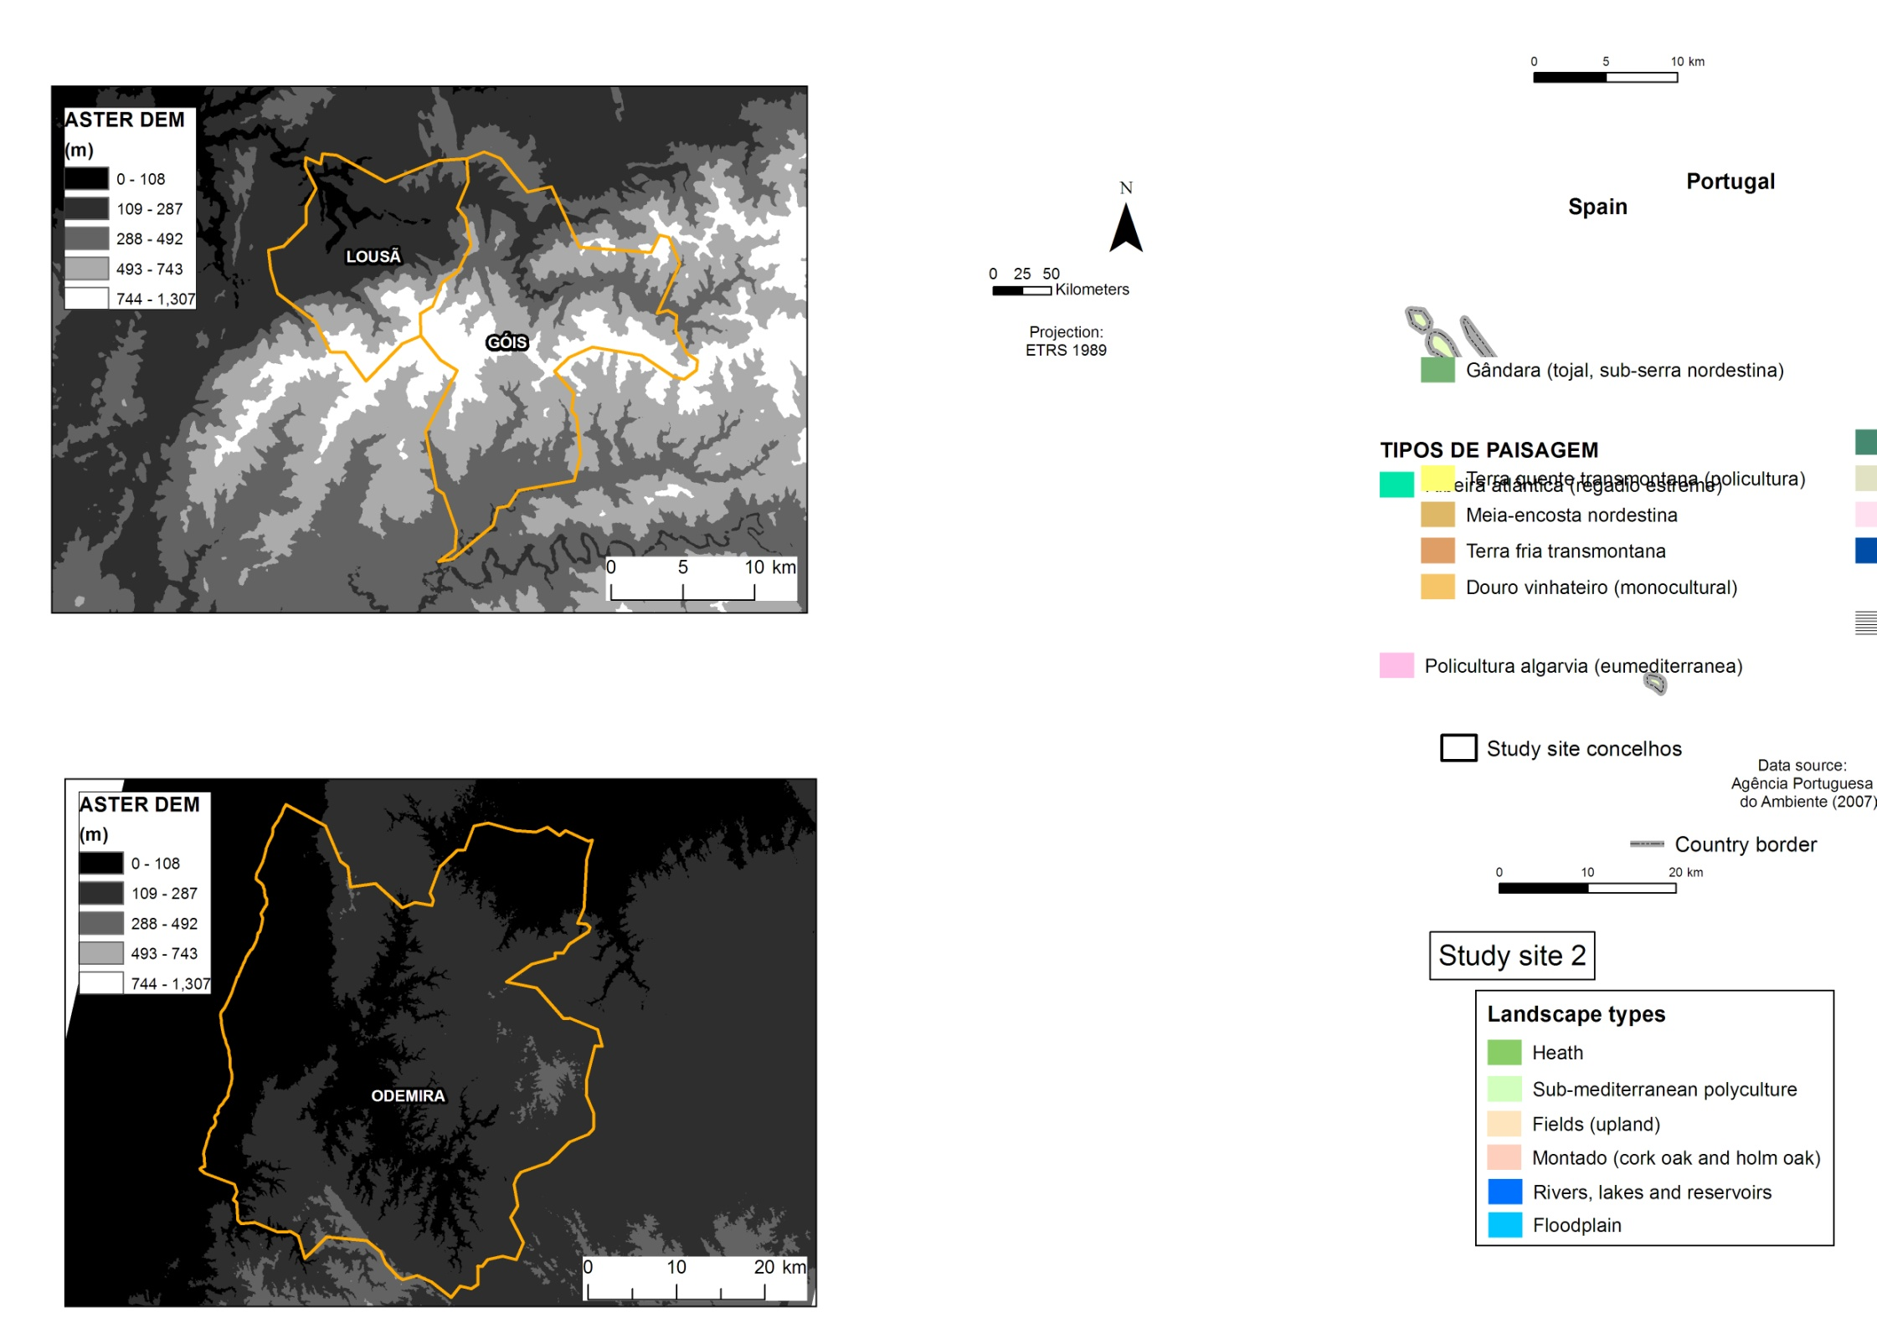
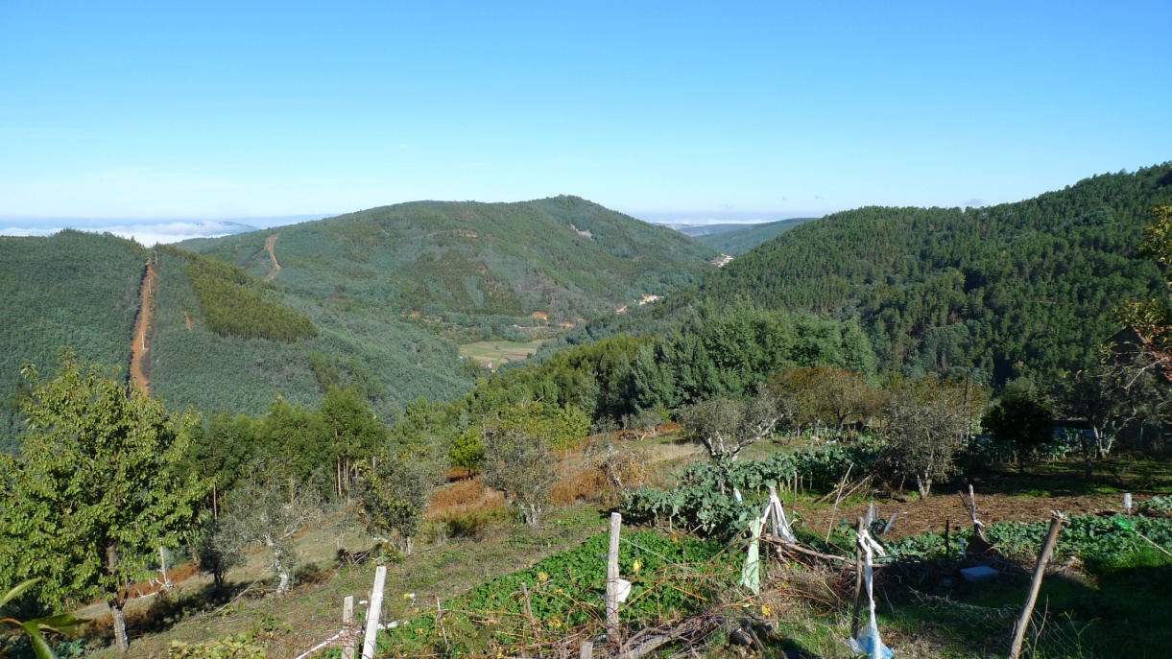

Study sites
Odemira
Odemira
Serra da Lousã
5 of 16

Slide 7
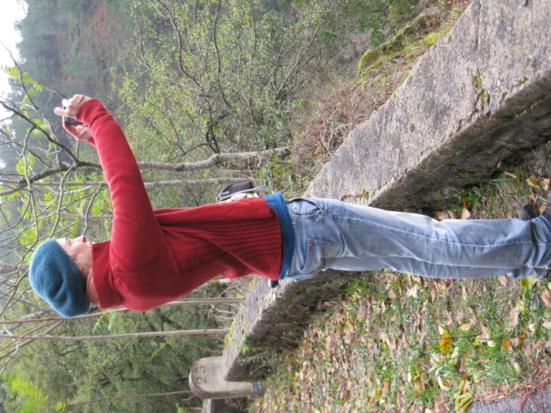
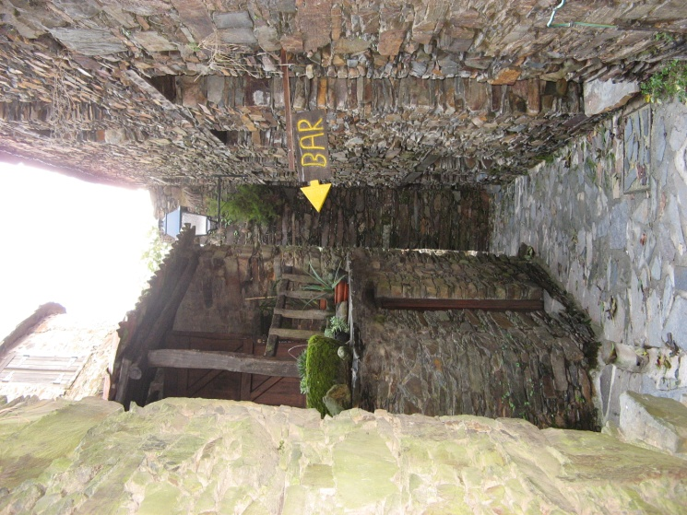
Approach 1: Participant interviews
Participants
Study site 1
Participants
Study site 2
DEM-based
Study site 1
DEM-based
Study site 2
Methodology
Videos of each study site
‘Please name the landforms you see
and the places you recognise.’
CamStudio
Participant information
Participants had lived in the area
for more than 5 years
Lousã - 10 participants,
Odemira - 11 participants
6 of 16

Slide 8
Quantitative data extraction
Terms for each landform listed
Land cover and land-use terms not included unless a part of landform term
Water bodies included
Low-count nominal data
no statistical significance
testing possible
7 of 16

Slide 9
Quantitative results comparison
Landscape familiarity
Landscape type
landscape level
place level
Landscape type
landscape level
place level
 | Lousã participants |  | Odemira participants
 | Term Count | Proportion of term use | Term Count | Proportion of term use
Lousã video | 30 | 68 % | 18 | 53 %
Odemira video | 27 | 61 % | 26 | 76 %
Total count of distinct terms | 44 |  | 34
8 of 16

Slide 10
Quantitative results comparison
Landscape familiarity
Landscape type
Positive relationship between
place recognition and description detail
landscape level
place level
 | Correlation coefficient
Lousã | 0.55
Odemira | 0.74
9 of 16

Slide 11
Quantitative results comparison
1 | Low lands |  | 7 | Hills |  | 10 | Serra Variations |  | 14 | Lombo
 | Várzea |  |  | Colina |  |  | Pequena serra |  | 15 | Cordilheira
 | Várzea grande |  |  | Morro |  |  | Serrazinhas |  | 16 | Perfil da montanha
 | Baixio |  |  | Cabeço |  |  | Serrinha |  | 17 | Rio and ribeiro
 | Baixa |  |  | Penedo |  |  | Serra maior |  |  | Rio
 | Terreno chão e alagadiço |  |  | Elevações |  |  | Serra alta |  |  | Ribeiro
 | Lezíria |  |  | Elevaçãozinha |  | 11 | Montanha |  | 18 | Water-related
 | Planalto |  | 8 | Slopes |  | 12 | Montanha variations |  |  | Margens do rio
 | Pequeno planalto |  |  | Encosta |  |  | Mini-montanha |  |  | Passagem de água
 | Plana |  |  | Encostazinha |  |  | Montanha baixa |  |  | Linhas da água
2 | Planicie |  |  | Encosta abruptas |  |  | Montanhas suave |  |  | Bacia
3 | Vale variations |  |  | Ladeira |  |  | Montanha pequena
 | Vale |  |  | Inclinado |  |  | Montanha alta
 | Vale fundo |  |  | Poco inclinado |  | 13 | Ridge/ peak
4 | Arriba |  |  | Inclinação |  |  | Cumeeira
5 | Monte |  |  | Rampa |  |  | Cume de montanha
6 | Monte variations |  | 9 | Serra |  |  | Cume da serra
 | Montezinhas |  |  |  |  |  | Cume da encosta
 | Pequeno monte |  |  |  |  |  | Cumeada
 | Monte grande |  |  |  |  |  | Pico da montanha
Landscape familiarity
Landscape type
landscape level
place level
Common for Lousã
Common for both
Common for Odemira
10 of 16

Slide 12
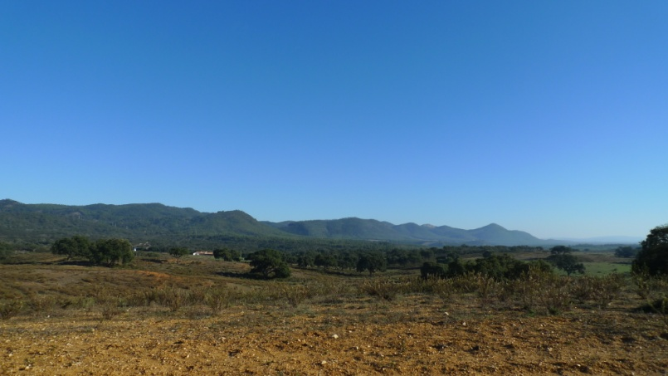
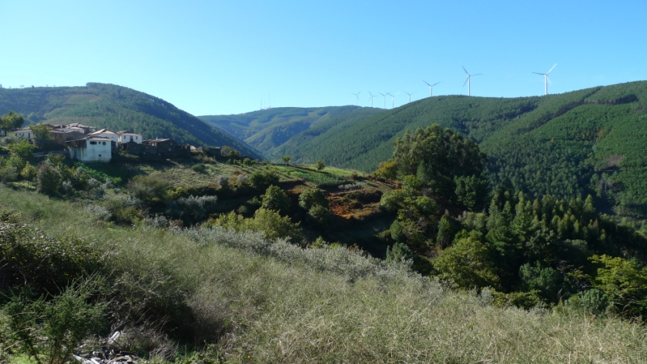
Qualitative results comparison
When places recognised
reference to mental maps
‘zoomed in’ perspective
landforms connected
descriptions from egocentric
reference frame
greater enthusiasm
11 of 16

Slide 13
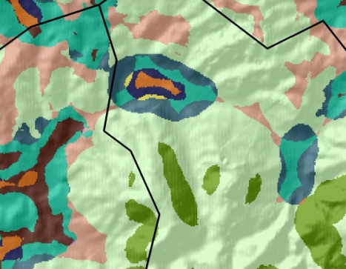
Approach 2: DEM-based classification
ASTER 30m DEM
Hammond macro scale landform
classification
Slope + Profile + Relief
Morgan and Lesh (2005)⁽¹⁾
ArcGIS methodology
Pixel based analysis
(1) Morgan, J. M. and Lesh, A. (2005) Developing Landform Maps Using ESRI’S ModelBuilder. ESRI International User Conference.
24 possible landform classes
12 of 16

Slide 14
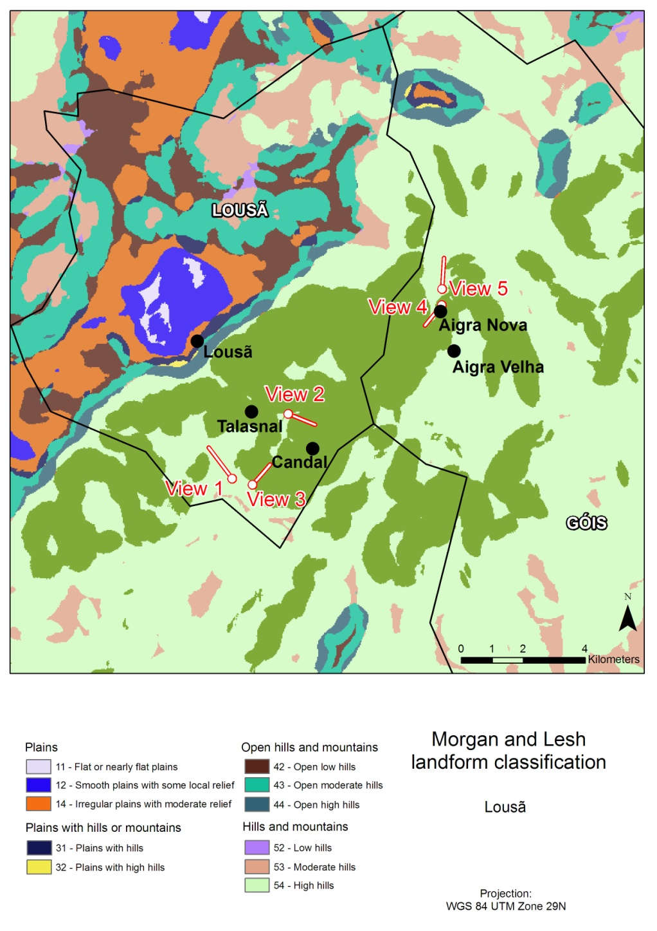
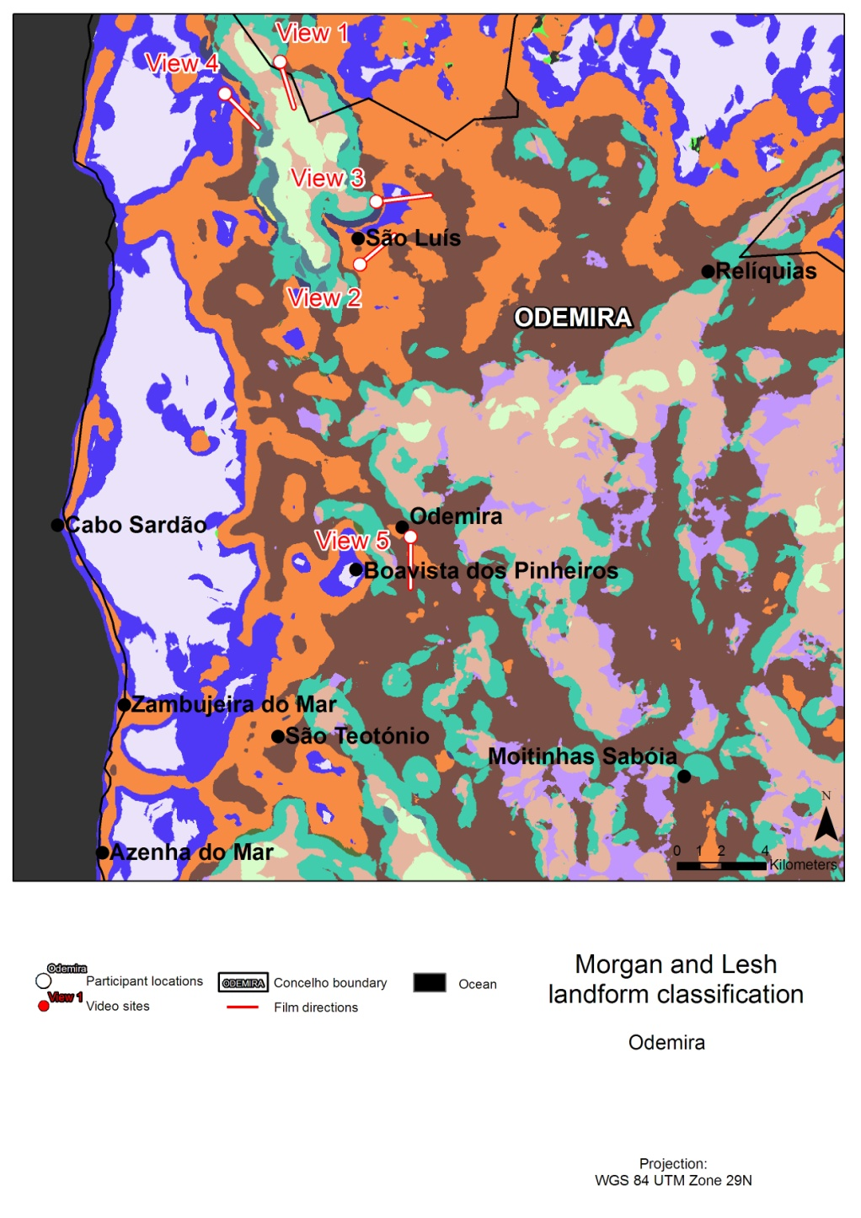
Landform classification
13 of 16

Slide 15
Classification vs participant categorisation
Morgan and Lesh class | Participant terms
14 - Irregular plains with moderate relief | Vale, Montanha, Monte
43 - Open moderate hills | Vale, Montanha, Monte
53 - Moderate hills | Vale, Montanha, Monte
54 - High hills | Montanha, Serra, Vale, Ladeira, Cume, Encostas abruptas
55 - Low mountains | Montanha, Serra, Cume/cumeada, Montes
Lousã
Odemira
12 - Smooth plains with some local relief | Planicie, Planalto
14 - Irregular plains with moderate relief | Várzea, Planicie,Planalto, Monte, Serra, Rio
31 - Plains with hills | Planicie, Monte
42 - Open low hills | Serra, Montanha, Monte, Vale
43 - Open moderate hills | Monte, Serra, Montanha
52 - Low hills | Serra, Montanha
53 - Moderate hills | Serra, Montanha
54 - High hills | Montanha, Serra
Slope change
14 of 16

Slide 16
Categorisation drivers
Salient features
Elevation and shape
Land cover and water
Utilitarian motivations
Land-use
Context
Clouds
Place familiarity
knowledge of landform connectivity
place name driving categorisation
15 of 16

Slide 17
Conclusions
Participants used more landform categories to describe familiar landscapes
Landform vocabulary matched landscape features
The DEM-based classification corresponded well to participant descriptions (at macro scale)
Evidence of multiple drivers for categorisation but none more predominant
16 of 16

Slide 18
The end!
Any questions?

Slide 19
Previous Research
Max Planck Institute for Psycholinguistics
Landscape terms and place names
Drivers for landform categorisation
National Center for Geographic Information and Analysis (NCGIA)
Geographic category norms study
Ethnophysiography
Geographic category norms study in Portugal
6 of 20

Slide 20
Limitations and future work
Differences in participant groups’ age/occupation/sex demographics
Study area size differences
Next:
More studies across Portugal
language — landscape relationships
Conceptual spaces
Landscape domain ontologies
Semantic similarity measures
20 of 20

